Slide 1
Spring Framework 3

Slide 2
Version Control and Revision History
 | Name | Date
Prepared By | Paranthaman | 09-07-2019
Reviewed By | Team | 09-07-2019
Approved By | Team | 09-07-2019
Version No. | Date | Affected Sections | Highlights
2.0.0 |  | ALL | Updated Based on the course sheet coverage

Slide 3
Objective
This course helps you to understand and implement Spring MVC Framework.

Slide 4
MVC
Spring offers rich support in the Web Tier:
  Spring MVC
    Spring’s own implementation of the Model 2 MVC architecture
    Flexible request mapping and handling
    Full forms support
    Supports multiple view technologies
    JSP Tag Library
  Support for Existing Web Frameworks
    Struts
    Tapestry
    JavaServerFaces
    WebWork

Slide 5
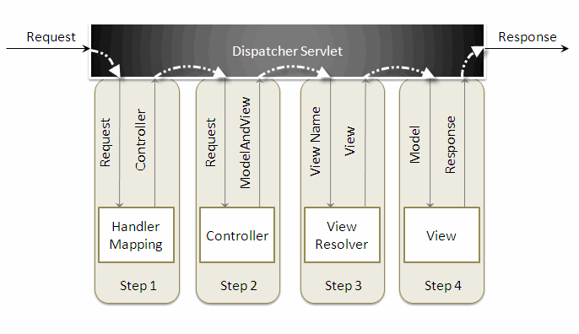
MVC

Slide 6
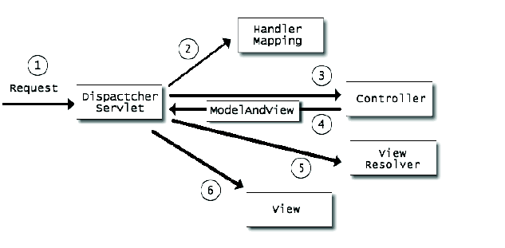
MVC
Spring MVC Lifecycle:

Slide 7
MVC
When a request is sent to the Spring MVC Framework the following sequence of events happen,
  The DispatcherServlet first receives the request.
  The DispatcherServlet consults the HandlerMapping and invokes the Controller associated with the request.
  The Controller process the request by calling the appropriate service methods and returns a ModeAndView object to the DispatcherServlet. The ModeAndView object contains the model data and the view name.
  The DispatcherServlet sends the view name to a ViewResolver to find the actual View to invoke.
  Now the DispatcherServlet will pass the model object to the View to render the result.
  The View with the help of the model data will render the result back to the user.

Slide 8
Spring in the Web Tier
Setting up a typical Spring MVC:
  Configure web.xml to map requests to Spring Front Controller
    Similar to Struts setup
  Configure web.xml to have Spring read additional bean definition files, if necessary ([servlet name]­servlet.xml loaded automatically)
    Spring supports either 2.3 (listeners) or 2.2 (startup servlet)
    Allows multiple bean configuration files to be loaded into single Application Context
  Write Controller classes and configure them in xml file
    Must map the controller to one or more URLs via an implementation of a HandlerMapping object
  Configure one or more view resolvers to tie controllers to views (JSP, Velocity template, etc.)
  Write the JSPs or other view artifacts to render the user interface

Slide 9
Integrating Spring
<?xml version="1.0" encoding="UTF-8"?>
<servlet>
<servlet-name>dispatcher</servlet-name>
<servlet-class> org.springframework.web.servlet.DispatcherServlet </servlet-class>
<load-on-startup>1</load-on-startup>
</servlet>
<servlet-mapping>
<servlet-name>dispatcher</servlet-name>
<url-pattern>*.htm</url-pattern>
</servlet-mapping>
<welcome-file-list>
<welcome-file>redirect.jsp</welcome-file>
</welcome-file-list>
</web-app>
Notes:
Here the servlet name is dispatcher. By default the DispatcherServlet will look for a file name dispatcher-servlet.xml to load the Spring MVC configuration. This file name is formed by concatenating the servlet name ("dispatcher") with "-servlet.xml". Here we user the the url-pattern as ".htm" inorder to hide the implementations technology to the users.
The redirect.jsp will be invoked first when we execute the Spring web application. This is the only jsp file outside the WEB-INF directory and it is here to provide a redirect to the DispatcherServlet. All the other views should be stored under the WEB-INF directory so that they can be invoked only through the controller process.

Slide 10
Configuring Spring (dispatcher-servlet.xml)
<bean id="viewResolver"
class=" org.springframework.web.servlet.view. InternalResourceViewResolver" >
<property name="prefix">
<value>/WEB-INF/jsp/</value>
</property>
<property name="suffix">
<value>.jsp</value>
</property>
</bean>
<bean name="/welcome.htm" class="com.mvcdemo.HelloWorldController" >
<property name="message" value="Hello World!" />
</bean>
</beans>
Notes:
Here the servlet name is dispatcher. By default the DispatcherServlet will look for a file name dispatcher-servlet.xml to load the Spring MVC configuration. This file name is formed by concatenating the servlet name ("dispatcher") with "-servlet.xml". Here we user the the url-pattern as ".htm" inorder to hide the implementations technology to the users.
The redirect.jsp will be invoked first when we execute the Spring web application. This is the only jsp file outside the WEB-INF directory and it is here to provide a redirect to the DispatcherServlet. All the other views should be stored under the WEB-INF directory so that they can be invoked only through the controller process.

Slide 11
Spring in the Web Tier
Controllers in Spring:
  Interface based
    Do not have to extend any base classes (as in Struts)
  • Have option of extending helpful base classes
    MultiAction
  Controllers
    Command Controllers
  • Dynamic binding of request parameters to POJO (no ActionForms!)
  • Use PropertyEditor features of JavaBeans to map complex types
    Form Controllers
  Hooks into cycle for overriding binding, validation, and inserting reference data
  Validation (including support for Commons Validation)
  Wizard style controller

Slide 12
Main Application
import javax.servlet.http.HttpServletRequest;
import javax.servlet.http.HttpServletResponse;
import org.springframework.web.servlet.ModelAndView;
import org.springframework.web.servlet.mvc.AbstractController;
public class HelloWorldController extends AbstractController {
private String message;
@Override
protected ModelAndView handleRequestInternal(HttpServletRequest request, HttpServletResponse response) throws Exception {
return new ModelAndView("welcomePage","welcomeMessage", message);
}
public void setMessage(String message) {
this.message = message; }
}

Slide 13
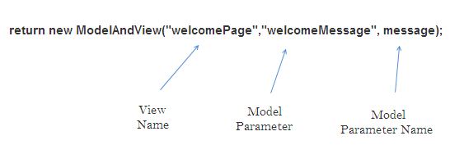
MVC

Slide 14
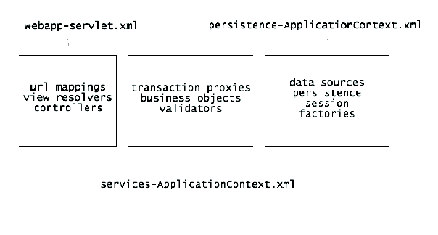
Spring in the Web Tier

